Slide 1



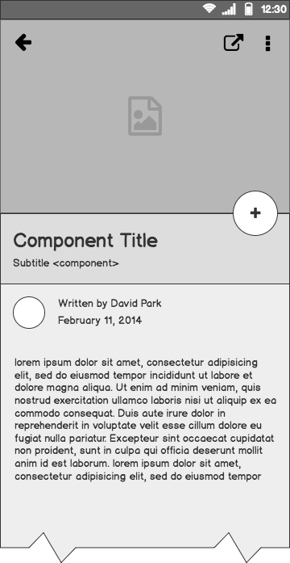
Reflectiva
A look reflects thousand words

Slide 2
Outline
The Problem
Solution Proposal
System design
System Modules
Next Steps

Slide 3
Problem statement
Classic user Feedback :
Reluctance to Provide Feedback
Biases and Subjectivity
Incomplete and Inaccurate Responses
Survey Design and Distribution
Time and Opportunity Costs

Slide 4
What customers do today
Customers like content creators rely on text feedback and surveys or uses solutions that need expensive equipment and long time calibration process

Slide 5
Solution Proposal
Develop a system that can extract user feedback in real-time while users passively engage with a product video

Slide 6
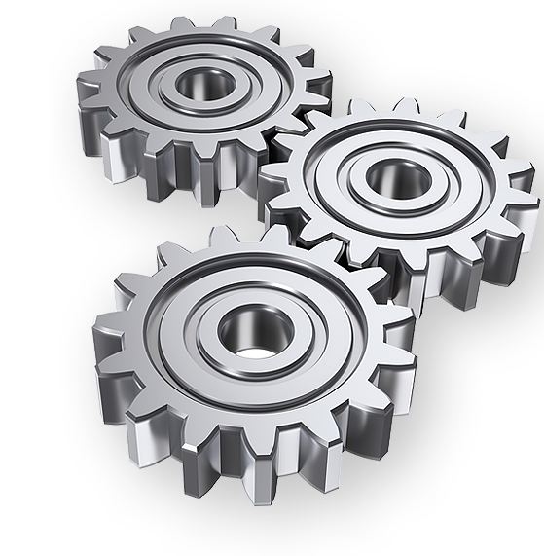
Targeted Customers
Market Research agencies
Media and Entertainment
Automotive and Fleet management
Education
Healthcare

Slide 7
System Design
Face Landmarks
Gaze Module
Analytics
FER Module
face detection

Slide 8
Facial expression recognition module

Slide 9
FER Approaches
Appearance based approaches
vs
feature based approaches

Slide 10
Landmarks approaches
Deep learning
VS
Image thresholding and morphological operations
VS
Supervised descent method

Slide 11
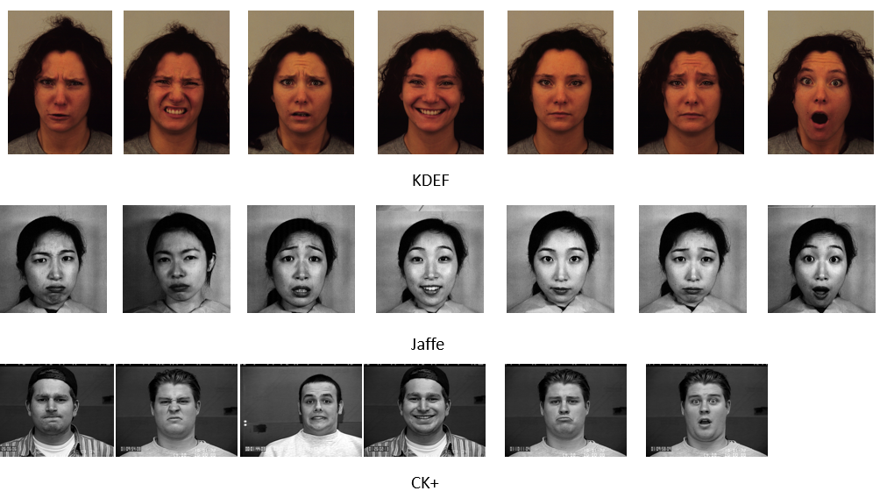
Data used

Slide 12
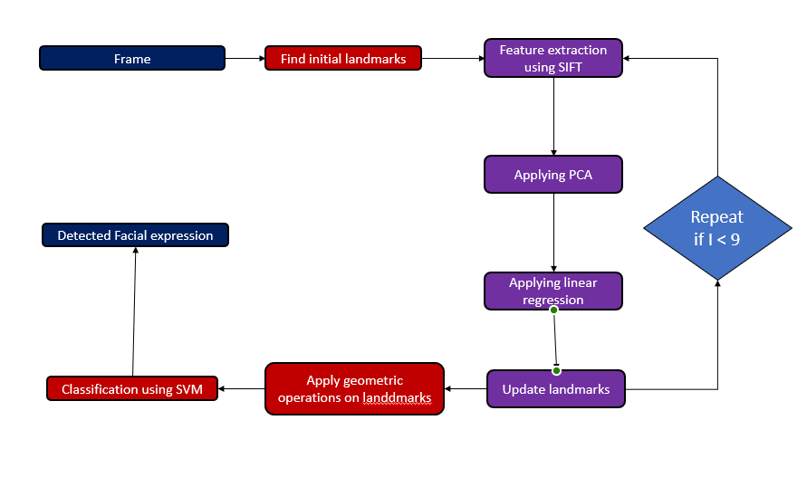
FER Pipeline

Slide 13
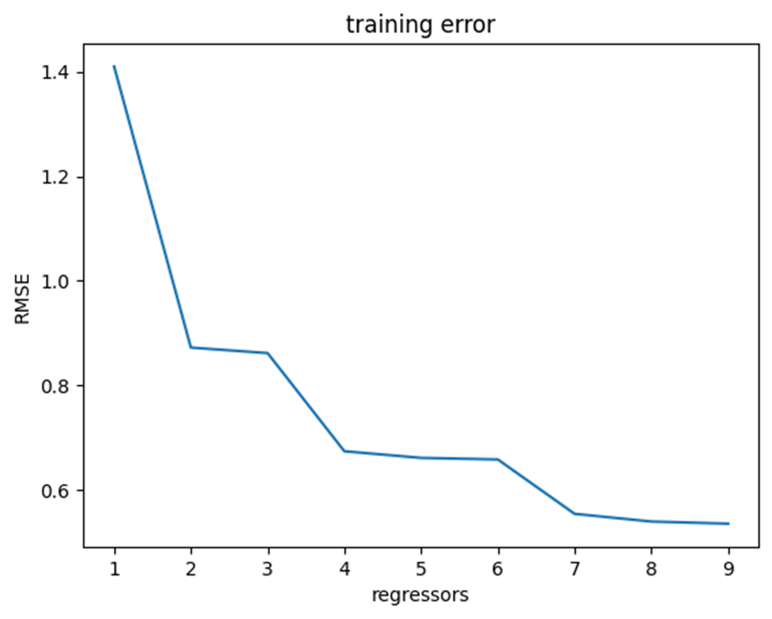
Landmarks Training error
RMSE on test set = 1.1774465

Slide 14
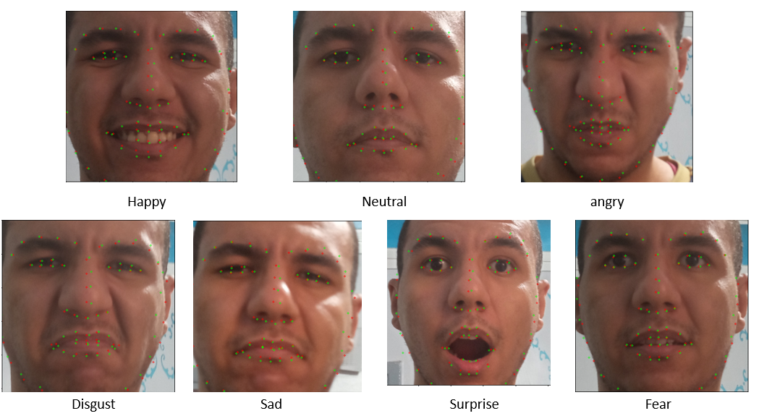
Our model VS Dlib landmarks

Slide 15
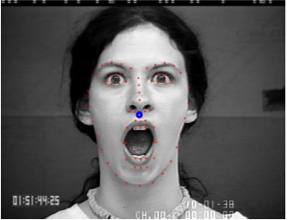
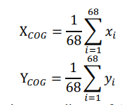
Geometrical operations Using COG

Slide 16
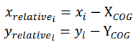
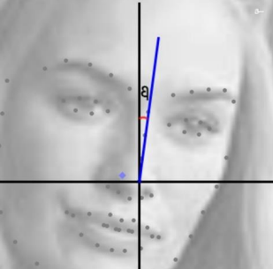
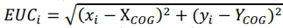
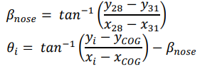
Geometric operation equation

Slide 17
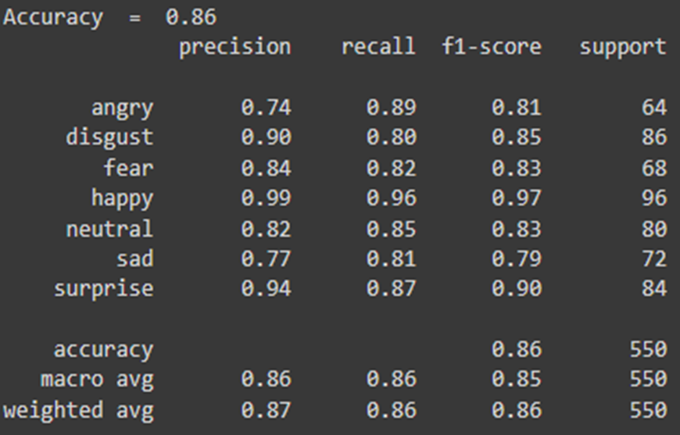
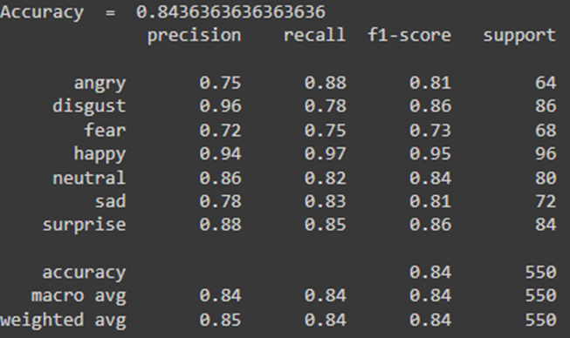
Results comparison
Accuracy of FER using Dlib landmarks
Accuracy of FER using Our model landmarks

Slide 18
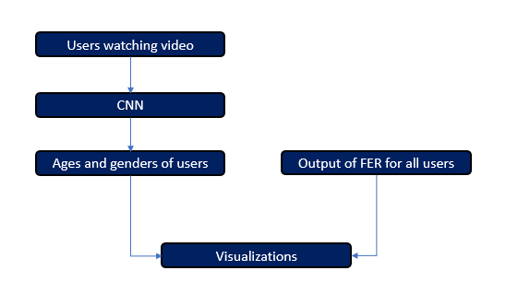
Data analysis

Slide 19
CNN for age and gender
UTK-faces dataset was used
Accuracy for age = 90.5
Accuracy for gender = 76.6

Slide 20
Face detection Module

Slide 21
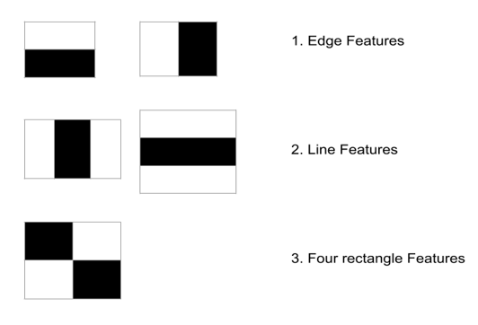
Haar features

Slide 22
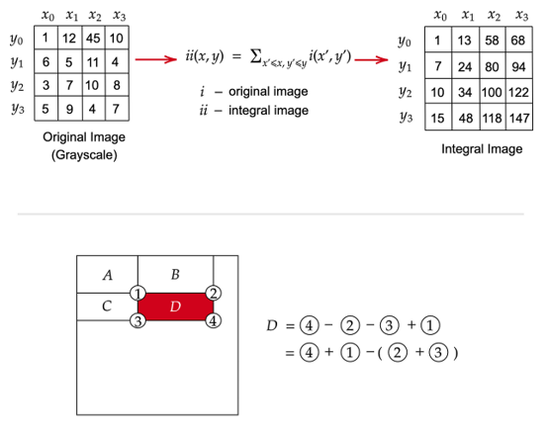
Integral Image

Slide 23
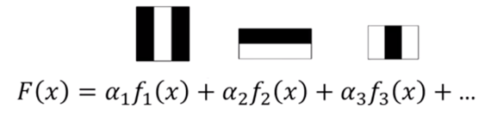
Adaboost

Slide 24
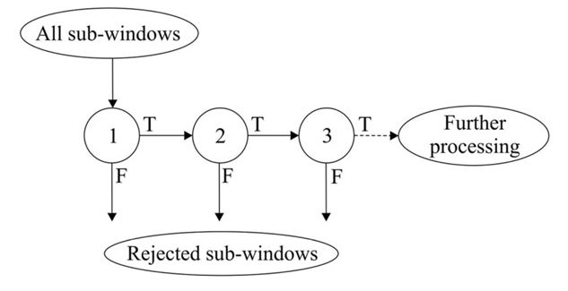
Cascading

Slide 25
Gaze tracking Module
Gaze estimation based on head pose estimation and eye iris pose to the eye contour points

Slide 26
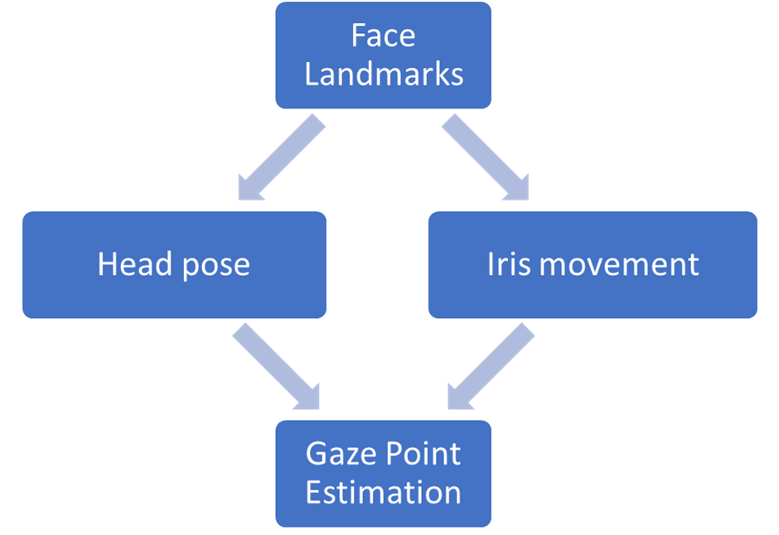
Module Design

Slide 27
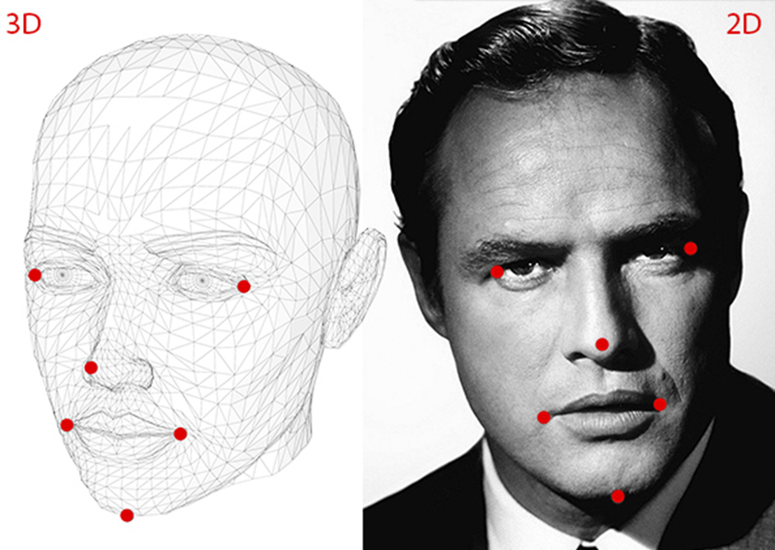
Head pose estimation

Slide 28
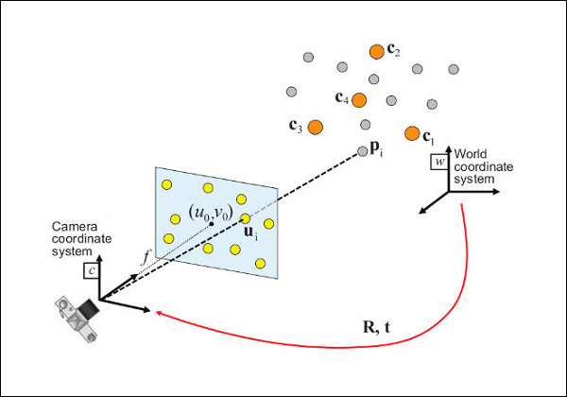
Head pose estimation Algorithm
Base on photogrametry:
Get the 2D and estimated 3D coordinates of the head key points
Feed the data to opencv solvepnp to get the camera rotation and translation matrices
Use the rotation matrix to infer the head direction
Use the head angle to get gaze direction

Slide 29
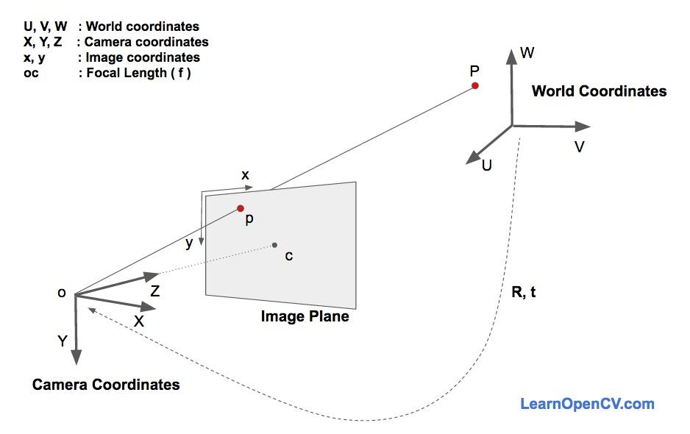
Assumptions
The camera is calibrated
The focal length is the image width
There is no distortion matrix ( Assumed to zeros)
The user distance is about 50-60cm

Slide 30
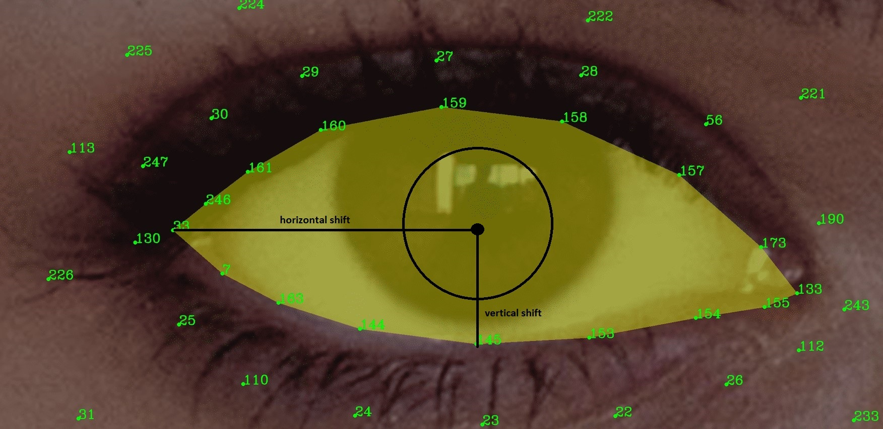
IRIS tracking

Slide 31
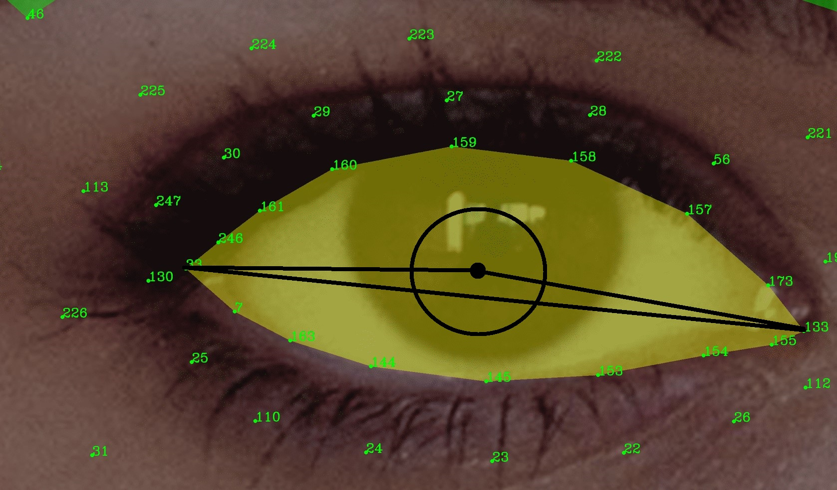
Iris tracking
Get the 2D landmark array of the eye and iris
Calculate the distance from iris center point to eye rightmost and leftmost point
Get the ratio from one point to the total range
Feed the ratio to direction module

Slide 32
Why it’s better than existing solutions
We uses the laptop camera or any camera available not a specialized hardware like 3D cameras.

Slide 33

Market Survey
:( Affectiva

Slide 34
Next Steps

Slide 35
What next?
Enhance accuracy
Extend dataset
Enhance estimations given different poses

